Slide 1
Ch.1Why Software Engineering

Slide 2
Why Software Engineering
Software pervades our world
Today ,software is working both explicitly and behind the scenes in virtually all aspects of our lives, including the critical systems that affect our health and well-being. For this reason, software engineering is more important than ever.
Good Software Engineering practices must ensure that software makes a positive contribution to how we lead our lives.

Slide 3
Solving problems
Analyzing
  Breaking the problem into pieces that we can understand and try to deal with.
  The larger problem can be described as a collection of small problems and their interrelationships.
  The difficulties to analyzing is how breaking the problem into pieces
  Figure1.1,P3
Notes:
比如打帝国时代的游戏,分析胜利的原因

Slide 4
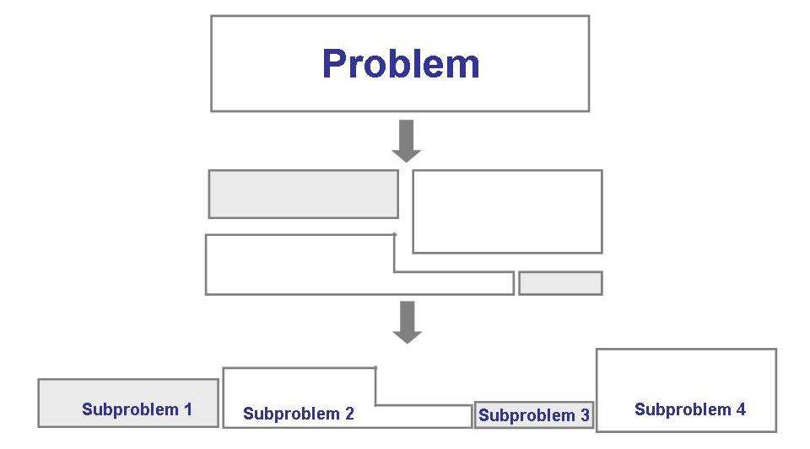
The analysis process

Slide 5
Solving problems
Synthesis
  Putting together of a large structure from small building blocks.
  Once the problem is analyzed, we must construct our solution from components that address the problem’s various aspects.
  Figure 1.2,p3
  The difficulties to Synthesis is how composing these individual solutions

Slide 6
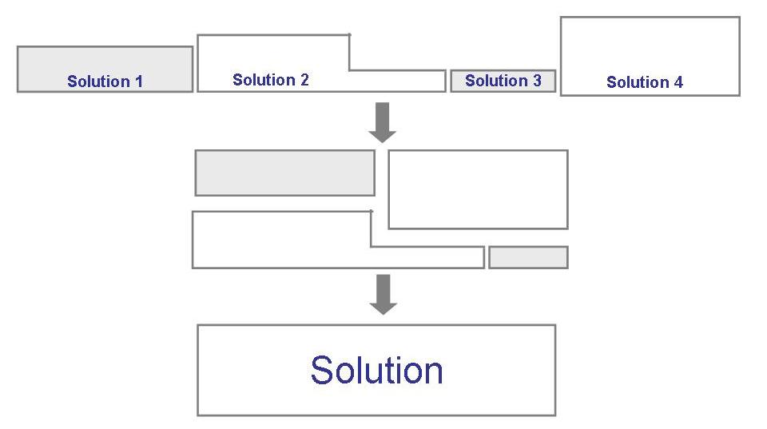
The synthesis process

Slide 7
Solving problems
A method or technique is a formal procedure（步骤） for producing some result.
A tool is an instrument or automated system for accomplishing something in a better way.
A procedure（过程） is a combination of tools and techniques that, in concert, produce a particular product.
A paradigm (范型，模型) is like a cooking style（烹饪风格）; it represents a particular approach or philosophy（哲学，理念） for building software. For example, we distinguish paradigms like object-oriented development from procedural ones.

Slide 8
1.2 How successful have we been? (第2节自学)
To achieve a aim, we have lots of ways, some ways are better than others. Better means short time and little money. So software engineering concerns with better ways to write program, not how to write program.
software engineering is about designing and developing high-quality software, how to write program is task of programming books.

Slide 9
1.2 how successful have we been
positive
  software has enabled us to perform tasks more quickly and efficiently than ever before.
Negative
  System function is not exactly as expected
  Systems barely work.
  Faulty programs: code that still contains mistakes

Slide 10
1.3 what is good software?
Perspective on quality
  The transcendental（先验论） view, where quality is something we can recognize but not define
  The user view, where quality is fitness for purpose
  The manufacturing view, where quality is conformance to specification
  The product view, where quality is tied to inherent product characteristics
  The value-based view, where quality depends on the amount the customer is willing to pay for it

Slide 11
Consider quality in at least three ways
The quality of the product
The quality of the process that results in the product
The quality of the product in the context of the business environment in which the product will be used.
  Faults tolerated in word processing software may not be acceptable in safety-critical or mission-critical systems

Slide 12
The quality of product
Users judge software to be high quality if it dose what they want in a way that is easy to learn and easy to use
Sometimes quality and functionality are intertwined
McCall’s quality model: Figure 1.5,P11
  Relate the user’s external view to the developer’s internal view of the software

Slide 13
The quality of process
Because the process results in the products, so the quality of the development and maintenance process is as important as product quality
In the 1990s, a well-publicized focus on process modeling and process improvement in software engineering.
  By improving the software development process, we can improve the quality of the resulting products

Slide 14
Quality in the context of the business environment
In a business perspective, the quality is viewed in terms of the products and services being provided by the business in which the software is embedded. So, the quality of the software in business environment is the business value of the software。
Business value and technical value of software products
  The business value is concerned more than the technical value in companies

Slide 15
1.4 who dose software engineering?
Participants in software development
  Customer
    The company, organization or person who is paying for the software system to be developed
    Being in control od the funds, usually negotiates the contrat and signs the acceptance papers.
  Developer
    The company, organization or person who is building the software system for the customer
  User
    The person or people who will actually use the system
  Figure 1.7,P15

Slide 16
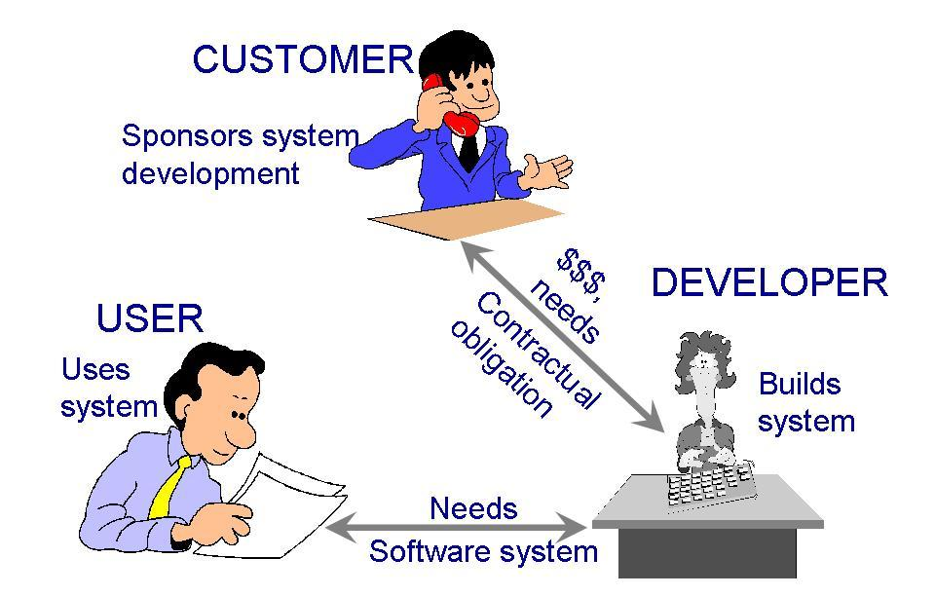
Participants (stakeholders) in a software development project

Slide 17
1.5 A system approach
Boundaries of the project
  A context (环境，范围) for the project, what is included in the project and what is not.
A System is a collection of objects and activities, plus a description of the relationships that tie the objects and activities together.
  Typically, our system definition includes, for each activity, a list of inputs required, action taken and outputs produced.
  Thus, to begin, we must know whether any object or activity is included in the system or not.

Slide 18
Relationship and the system boundary
Relationship
  Once entities and activities are defined, we match the entities with their activities. The relationships among entities and activities are clearly an carefully defined.
Boundary or border
  Some items cross the boundary to enter our system, and others are products of our system and travel out for another system’s use
System
  A collection of things: a set of entities, a set of activities, a description of the relationships among entities and activities, and a definition of the boundary of the system
Figure 1.8 respiratory(呼吸) system,P18

Slide 19
1.6 An engineering approach
Building a house
  The first event involved in the house building is a conference between the clients and the developers so the clients can explain what they want.
  Then the designers draws up floor plans(平面图) and an architect’s rendering(结构示意图，透视图) of the house.
  Once the clients give their approval to the plans, construction begins.
  During the construction process, the clients would like change thinking about the house’s construction.
  Before the clients move in the completed house, several components of the house are tested.
  Finally, the clients move in the house, if there is something that is not constructed properly, the developers may be called in to fix it.

Slide 20
1.6 An engineering approach
building a system: similar to building a house.
Software development process
  Requirements analysis and definition
  System design
  Program design
  Writing programs (program implementation)
  Unit testing
  Integration testing
  System testing
  System delivery
  Maintenance

Slide 21
1.7 members of the development team
Requirements analysts
  Breaking down what the customer wants into discrete requirements
Designers
  Generate a system-level description of what the system is to do
Programmers
  Write lines of code that implement what the requirements specify
Testers
  Catch faults
Trainers
  Show users how to use the system

Slide 22
1.7 members of the development team
Maintenance team
  Fix the faults are discovered after the system has been accepted.
Librarians
  Prepare and store documents that are used during the life of the system.
Configuration management team
  Maintain a correspondence among the requirements, the design, the implementation, and the test.
Figure 1.11 P26 the roles of development team

Slide 23
1.8 how has software engineering changed?
Software development allows the customer to review the plans at every step and to make changes in the design, so software engineer must keep his eyes on flexibility. We can not assumed our customers knew from the start what they wanted. That stability is not usually the case.
We must also acknowledge that most systems do not stand by themselves, but interface with other systems, either to receive or to provide information. They require a great deal of coordination with other systems, we are difficult to assure the interface with other systems.

Slide 24
The seven key factors that have altered software engineering practices ( concluded by Wasserman )
criticality of time-to-market for commercial products
shifts in economics of computing :lower hardware costs and greater development and maintenance costs
availability of powerful desktop computing
extensive local- and wide-area networking
availability and adoption of object-oriented technology
graphical user interfaces using windows, icons, menus, and pointers
unpredictability of waterfall model of development
Figure 1.12 P29

Slide 25
Eight fundamental notions(概念) in software engineering that form the basis for an effective discipline of software engineering
1. Abstraction
  Is a description of the problem at some level of generalization that allows us to concentrate on the key aspects of the problem without getting mired in the details.
  Typically, abstraction involves identifying classes of objects that allow us to group items together; this way, we can deal with fewer things and concentrate on the commonalities of the items (objects) in each class. The classes help us to simplify the problem statement and focus on the essential elements or characteristics of the problem.

Slide 26
2. Analysis and design methods(方法) and notations（表示符号）
Standard notation（符号，标记） help us to communication each other. More importantly, the common notation allows the building contractor to understand the architect’s intent and ideas.
Analysis and design methods offer亅more than communication medium, they also allow us to build models and check them for completeness(完整性) and consistence（一致性）. Moreover, we can more readily reuse requirements and design components from previous projects, increasing our productivity and quality with relative ease.

Slide 27
3. User interface prototyping
Prototyping means building a small version of a system, usually with limited functionality, that can be used to
  help the user or customer identify the key requirement of a system
  demonstrate feasibility of a design or approach
The prototyping process is iterative: build prototype, evaluate it, change it with user’s feedback, the iteration ends when we and user make a compromise
Prototyping is often used to design a good user interface: the part of the system with which the user interacts.

Slide 28
4. Software architecture
A system’s architecture describes the system in terms of a set of architectural units, and a map of how the units relate to one another. The more independent the units, the more modular the architecture and the more easily we can design and develop the pieces separately.

Slide 29
5. Software process
We need pay careful attention to the process of developing software（开发过程的质量对产品质量有重大影响）, as well as the products that result. the organization(良好组织) and discipline（纪律规范） in the process activities have been acknowledged to contribute to the quality of the software and to the speed with which it is developed.
Different types of software need different processes, Enterprise wide application need controlled development process (need a great deal of control); whereas individual and departmental application can take the advantage of rapid application development (little, even no control).

Slide 30
6.Reuse
We often take advantage of the commonalities across applications by reusing items from previous development.
Reuse items from previous development
The reusable components as a business asset, companies and organizations invest in items that are reusable and then gain quantifiable benefit when those items are used again in subsequent projects.

Slide 31
7.measurement
Improvement is a driving force in software engineering research: improving our processes, resources, and methods so that we produce and maintain better products.
Software measurement has become a key aspect of good software engineering practice. By quantifying(量化) where we can and what we can, we describe our actions and their outcomes in a common mathematical language that allows us to evaluate our progress.
Quantitative approach permits us to compare progress across disparate projects(比较不同项目的进步).

Slide 32
8. Tools and integrated environments
Standardized, integrated development environments would enhance software development
The eight concept can be thought as eight threads woven through the fabric of this book.

